Slide 1
Introduction
An effective presentation of the data often quickly reveals important features such as
their range,
degree of symmetry,
how concentrated or spread out they are,
where they are concentrated, and so on.
In this lecture we will be concerned with techniques, both tabular and graphic, for presenting data sets.
Graph for Categorical Variables
Frequency tables
The histogram
The stem-and-leaf plot
The scatter diagram

Slide 2
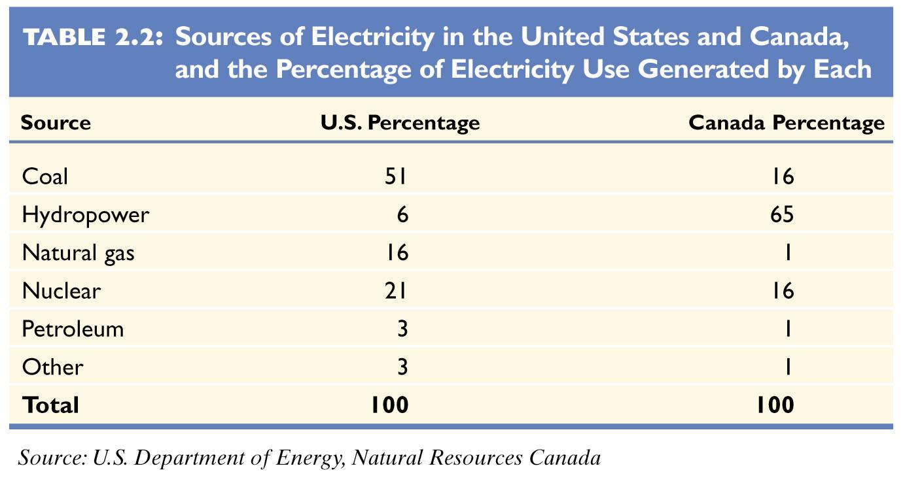
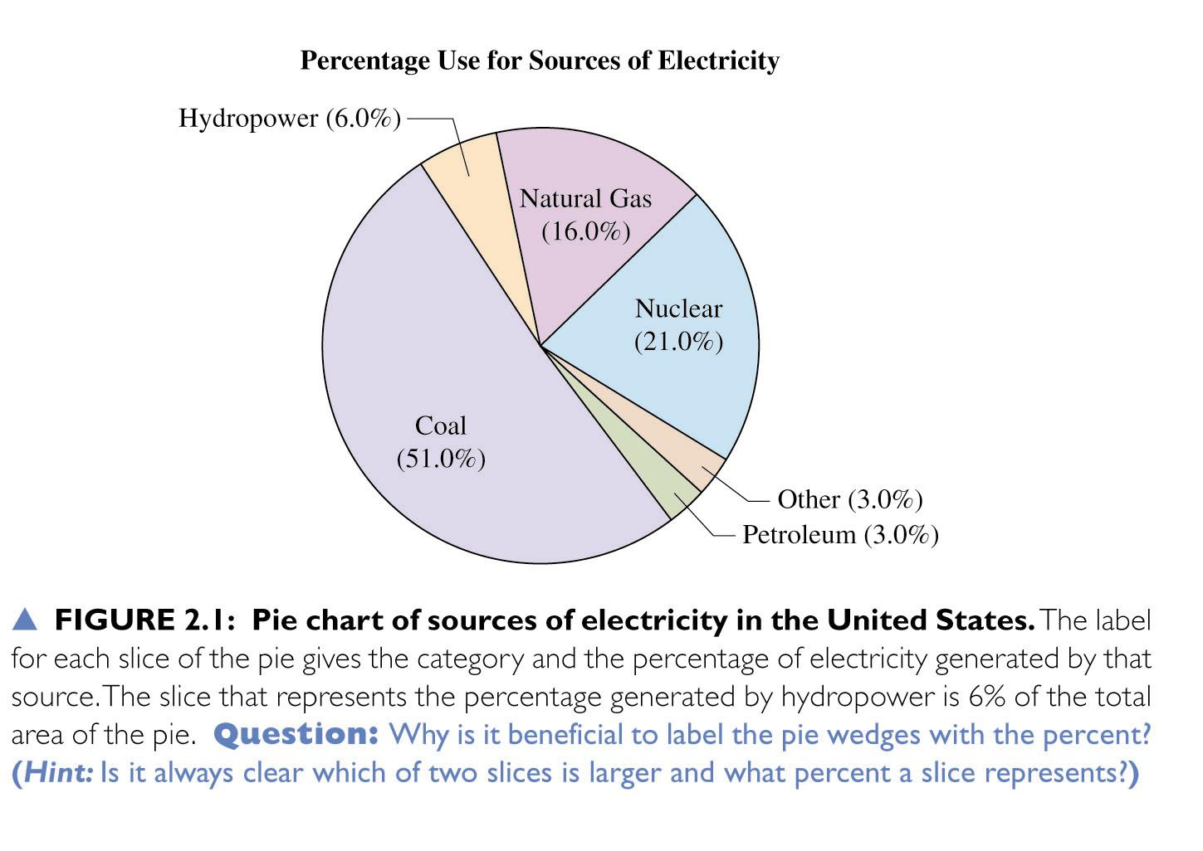
Pie Charts
Summarize categorical variable
Drawn as circle where each category is a slice
The size of each slice is proportional to the percentage in that category

Slide 3
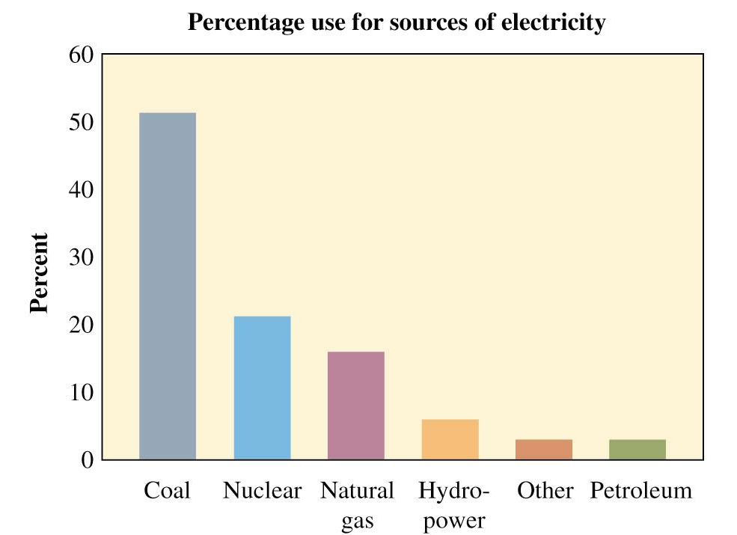
Bar Graphs
Summarizes categorical variable
Vertical bars for each category
Height of each bar represents either counts or percentages
Easier to compare categories with bar graph than with pie chart
Called Pareto Charts when ordered from tallest to shortest

Slide 4
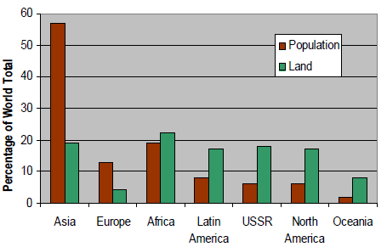
Multiple Bar Graphs
Also called compound bar charts
More then one sub-attribute of variable can be expressed
Used for compare data

Slide 5
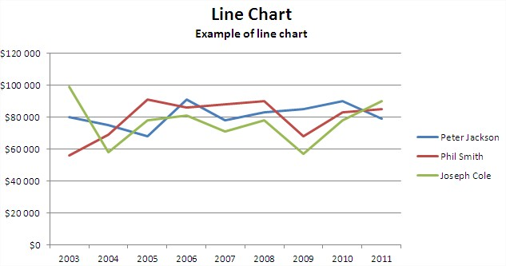
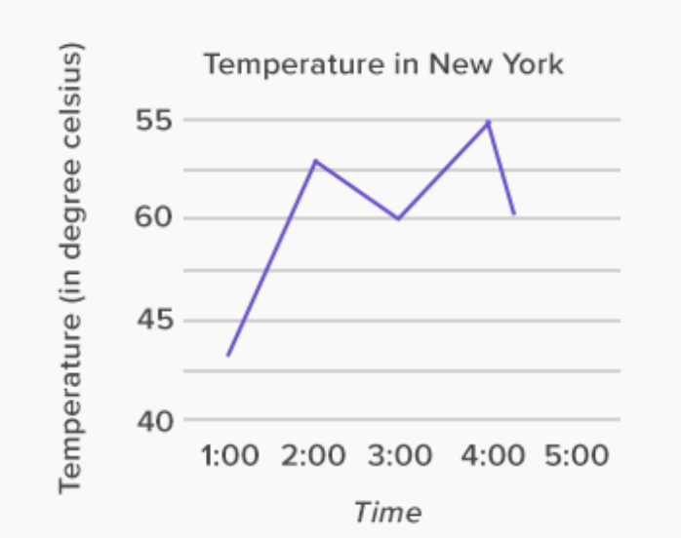
Line Graph
Line diagrams are used to show the trend of events with the passage of time.

Slide 6
Frequency Distribution
Frequency Distribution: A listing, often expressed in chart form, that pairs each value of a variable with its frequency
Ungrouped Frequency Distribution: Each value of x in the distribution stands alone
Grouped Frequency Distribution: Group the values into a set of classes

Slide 7
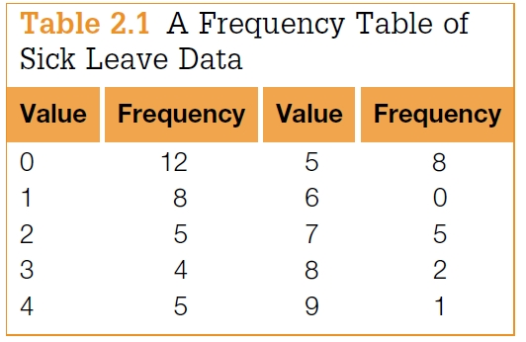
Ungrouped Frequency Distribution
The following data represent the number of days of sick leave taken by each of 50 workers of a given company over the last 6 weeks:
2, 2, 0, 0, 5, 8, 3, 4, 1, 0, 0, 7, 1, 7, 1, 5, 4, 0, 4, 0, 1,8, 9, 7, 0,1, 7, 2, 5, 5, 4, 3, 3, 0, 0, 2, 5, 1, 3, 0, 1, 0, 2, 4, 5, 0, 5, 7, 5, 1
Frequency tables

Slide 8
Example 2.1
Use Table 2.1 to answer the following questions:
(a) How many workers had at least 1 day of sick leave?
(b) How many workers had between 3 and 5 days of sick leave?
(c) How many workers had more than 5 days of sick leave?
Solution
(a) Since 12 of the 50 workers had no days of sick leave, the answer is 50 −12 = 38.
(b) The answer is the sum of the frequencies for values 3, 4, and 5; that is, 4 + 5 + 8 = 17.
(c) The answer is the sum of the frequencies for the values 6, 7, 8, and 9. Therefore, the answer is 0 + 5 + 2 + 1 = 8.

Slide 9
Grouped Frequency Distribution
Group the values into a set of classes
A table that summarizes data by classes, or class intervals
In a typical grouped frequency distribution, there are usually 5-12 classes of equal width
The table may contain columns for class number, class interval, frequency, relative frequency, cumulative relative frequency, and class midpoint

Slide 10
Grouped Frequency Distribution (Cont…)
Guidelines for constructing a frequency distribution:
For some data sets the number of distinct values is too large to utilize.
In such cases, we divide the values into groupings, or class intervals.
The number of class intervals chosen should be a trade-off between
(1) choosing too few classes at a cost of losing too much information about the actual data values in a class and
(2) choosing too many classes, which will result in the frequencies of each class being too small for a pattern to be discernible.
Generally, 5 to 10 class intervals are typical.

Slide 11
Grouped Frequency Distribution (Cont…)
Guidelines for constructing a frequency distribution:
All classes should be of the same width
Classes should be set up so that they do not overlap and so that each piece of data belongs to exactly one class
5-12 classes are most desirable. The square root of n is a reasonable guideline for the number of classes if n is less than 150.

Slide 12
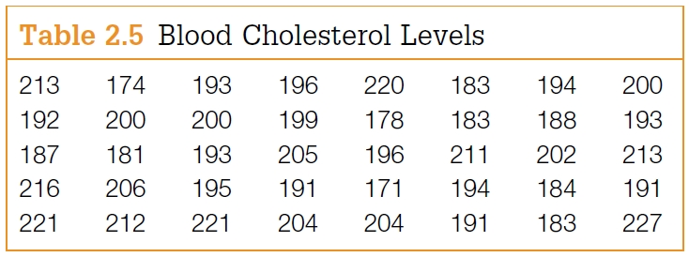
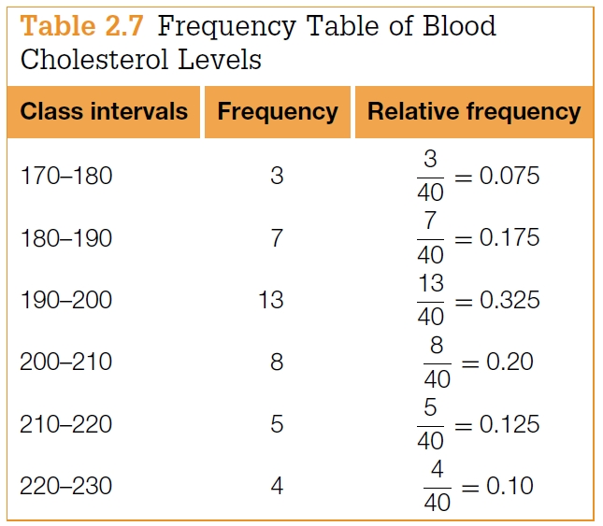
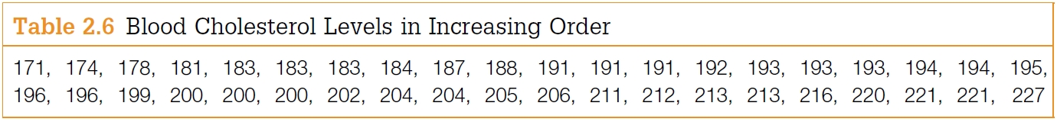
Grouped Frequency Distribution (Cont…)
Class boundaries
the endpoints of a class interval
Left-end inclusion convention
a class interval contains its left-end but not its right-end boundary point.
for instance
the class interval 20–30 contains all values that are both greater than or equal to 20 and less than 30

Slide 13
Grouped Frequency Distribution (Cont…)
Procedure for constructing a frequency distribution:
1. Identify the high (H) and low (L) scores. Find the range. Range = H - L
2. Select a number of classes and a class width so that the product is a bit larger than the range
3. Pick a starting point a little smaller than L. Count from L by the width to obtain the class boundaries. Observations that fall on class boundaries are placed into the class interval to the right.

Slide 14
Example
Example: The hemoglobin test, a blood test given to diabetics during their periodic checkups, indicates the level of control of blood sugar during the past two to three months. The data in the table below was obtained for 40 different diabetics at a university clinic that treats diabetic patients:
6.5 5.0 5.6 7.6 4.8 8.0 7.5 7.9 8.0 9.2
6.4 6.0 5.6 6.0 5.7 9.2 8.1 8.0 6.5 6.6
5.0 8.0 6.5 6.1 6.4 6.6 7.2 5.9 4.0 5.7
7.9 6.0 5.6 6.0 6.2 7.7 6.7 7.7 8.2 9.0
1) Construct a grouped frequency distribution using the classes 3.7 - 4.7, 4.7 - 5.7, 5.7 - 6.7, etc.
2) Which class has the highest frequency?

Slide 15
Solutions
1)
Class Frequency Relative Cumulative Class
Boundaries f Frequency Rel. Frequency Midpoint, x
---------------------------------------------------------------------------------------
3.7 - 4.7 1 0.025 0.025 4.2
4.7 - 5.7 6 0.150 0.175 5.2
5.7 - 6.7 16 0.400 0.575 6.2
6.7 - 7.7 4 0.100 0.675 7.2
7.7 - 8.7 10 0.250 0.925 8.2
8.7 - 9.7 3 0.075 1.000 9.2
The class 5.7 - 6.7 has the highest frequency. The frequency is 16 and the relative frequency is 0.40
Relative frequency = (frequency/N)

Slide 16
Cumulative Frequency Distribution
Cumulative Frequency Distribution: A frequency distribution that pairs cumulative frequencies with values of the variable
The cumulative frequency for any given class is the sum of the frequency for that class and the frequencies of all classes of smaller values
The cumulative relative frequency for any given class is the sum of the relative frequency for that class and the relative frequencies of all classes of smaller values

Slide 17
Example
Example: A computer science aptitude test was given to 50 students. The table below summarizes the data:
Class Relative Cumulative Cumulative
Boundaries Frequency Frequency Frequency Rel. Frequency
-------------------------------------------------------------------------------------
0 up to 4 4 0.08 4 0.08
4 up to 8 8 0.16 12 0.24
8 up to 12 8 0.16 20 0.40
12 up to 16 20 0.40 40 0.80
16 up to 20 6 0.12 46 0.92
20 up to 24 3 0.06 49 0.98
24 up to 28 1 0.02 50 1.00

Slide 18
Ogive
Ogive: A line graph of a cumulative frequency or cumulative relative frequency distribution. An ogive has the following components:
1. A title, which identifies the population or sample
2. A vertical scale, which identifies either the cumulative frequencies or the cumulative relative frequencies
3. A horizontal scale, which identifies the upper class boundaries. Until the upper boundary of a class has been reached, you cannot be sure you have accumulated all the data in the class. Therefore, the horizontal scale for an ogive is always based on the upper class boundaries.
Note: Every ogive starts on the left with a relative frequency of zero at the lower class boundary of the first class and ends on the right with a relative frequency of 100% at the upper class boundary of the last class.

Slide 19
Example
Example: The graph below is an ogive using cumulative relative frequencies for the computer science aptitude data:
Computer Science Aptitude Test
1.0
0.9
0.8
0.7
Cumulative Relative Frequency
0.6
0.5
0.4
0.3
0.2
0.1
0.0
0
4
8
12
16
20
24
28
Test Score

Slide 20
Stem & Leaf Display
Background:
The stem-and-leaf display has become very popular for summarizing numerical data
It is a combination of graphing and sorting
The actual data is part of the graph
Well-suited for computers
Stem-and-Leaf Display: Pictures the data of a sample using the actual digits that make up the data values. Each numerical data is divided into two parts: The leading digit(s) becomes the stem, and the trailing digit(s) becomes the leaf. The stems are located along the main axis, and a leaf for each piece of data is located so as to display the distribution of the data.

Slide 21
Example
Example: A city police officer, using radar, checked the speed of cars as they were traveling down the main street in town. Construct a stem-and-leaf plot for this data:
41 31 33 35 36 37 39 49
33 19 26 27 24 32 40
39 16 55 38 36
Solution:
All the speeds are in the 10s, 20s, 30s, 40s, and 50s. Use the first digit of each speed as the stem and the second digit as the leaf. Draw a vertical line and list the stems, in order to the left of the line. Place each leaf on its stem: place the trailing digit on the right side of the vertical line opposite its corresponding leading digit.

Slide 22
Example
20 Speeds
---------------------------------------
1 | 6 9
2 | 4 6 7
3 | 1 2 3 3 5 6 6 7 8 9 9
4 | 0 1 9
5 | 5
----------------------------------------
The speeds are centered around the 30s
Note: The display could be constructed so that only five possible values (instead of ten) could fall in each stem. What would the stems look like? Would there be a difference in appearance?

Slide 23
Histogram
Histogram: A bar graph representing a frequency distribution of a quantitative variable. A histogram is made up of the following components:
1. A title, which identifies the population of interest
2. A vertical scale, which identifies the frequencies in the various classes
3. A horizontal scale, which identifies the variable x. Values for the class boundaries or class midpoints may be labeled along the x-axis. Use whichever method of labeling the axis best presents the variable.
Notes:
The relative frequency is sometimes used on the vertical scale
It is possible to create a histogram based on class midpoints

Slide 24
Example
Example: Construct a histogram for the blood test results given in the previous example
The Hemoglobin Test
Solution:
1
5
1
0
Frequency
5
0
4
.
2
5
.
2
6
.
2
7
.
2
8
.
2
9
.
2
Blood Test

Slide 25
Example
Example: A recent survey of Roman Catholic nuns summarized their ages in the table below. Construct a histogram for this age data:
Age Frequency Class Midpoint
------------------------------------------------------------
20 up to 30 34 25
30 up to 40 58 35
40 up to 50 76 45
50 up to 60 187 55
60 up to 70 254 65
70 up to 80 241 75
80 up to 90 147 85

Slide 26
Solution
Roman Catholic Nuns
2
0
0
Frequency
1
0
0
0
2
5
3
5
4
5
5
5
6
5
7
5
8
5
Age

Slide 27
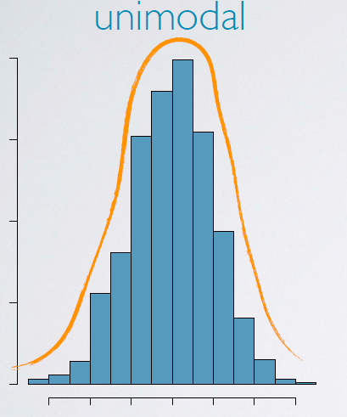
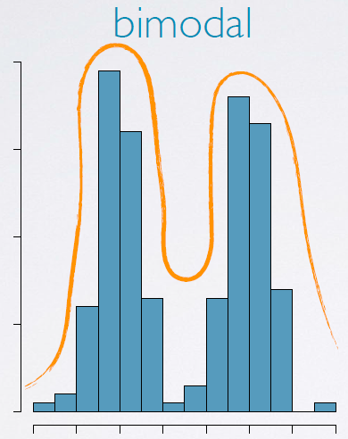
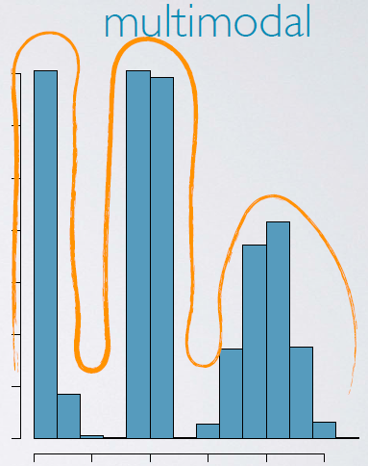
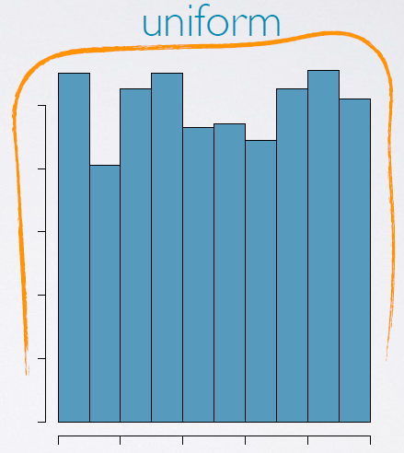
Modality of Histogram
Modality is also related to the shape of a histogram
Refers to the number of prominent peaks
Uni-modal
one prominent peak
Bi-modal
two prominent peaks
Multimodal
More than two prominent peaks
Uniform
no prominent peak

Slide 28
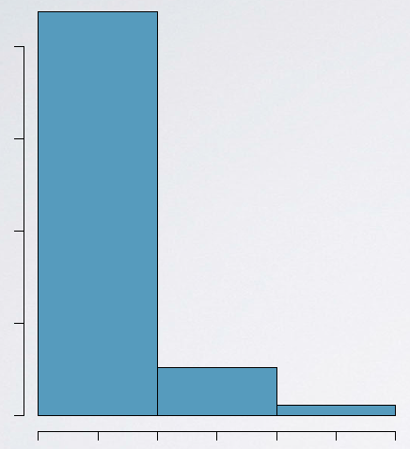
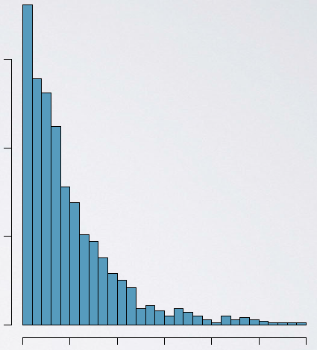
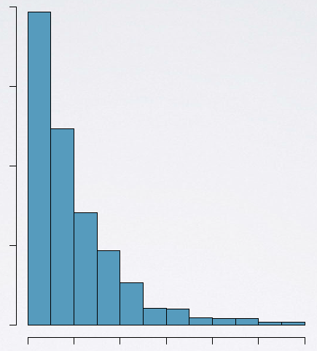
Bin Width of Histogram
The chosen bin width can alter the story that the histogram is telling.
Too large bin width → we may lose interesting details.
Too narrow bin width → difficult to get the overall picture of the distribution.
Ideal bin width depends on the data being analyzed
too wide
too narrow
“just" right.

Slide 29
The Difference Between Bar Charts and Histograms
With bar charts, each column represents a group defined by a categorical variable
With histograms, each column represents a group defined by a quantitative variable.
With bar charts, however, the X axis does not have a low end or a high end; because the labels on the X axis are categorical - not quantitative. As a result, it is not appropriate to comment on the skewness of a bar chart.

Slide 30
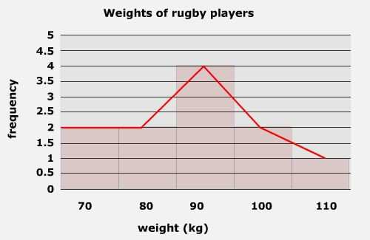
Frequency Polygon
A frequency polygon is a line graph of class frequency plotted against class mid-point.
It can be obtained by connecting the mid-points of the tops of the rectangles in the histogram or drawn as a line graph.

Slide 31
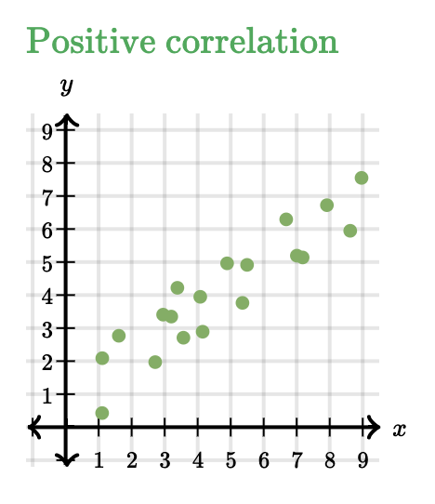
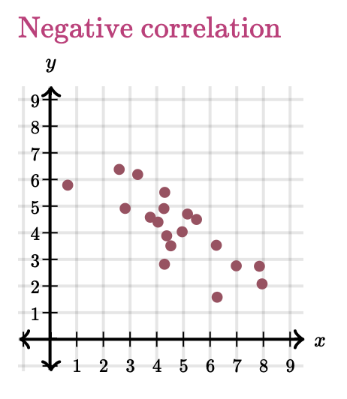
Scatterplot
Scatterplot: A type of data display that shows the relationship between two numerical variables.
The position of each dot on the horizontal and vertical axis indicates values for an individual data point
Used to observe relationships between variables.

